Slide 1
BJT AC Analysis
Topic 5 (Chapter 5)

Slide 2
5.2 AC Amplification
After a transistor has been biased with the Q point near the middle of the load line, we can couple a small ac voltage into the base (input).
  This will produce an ac collector voltage (output).
  The ac collector voltage looks like the ac base voltage, except that it's a lot bigger.
    In other words, the ac collector voltage is an amplified version of the ac base voltage.
The invention of amplifying devices, first vacuum tubes and later transistors, was crucial to the evolution of electronics.
  Without amplification, there would be no radio, no television, and no computers.

Slide 3
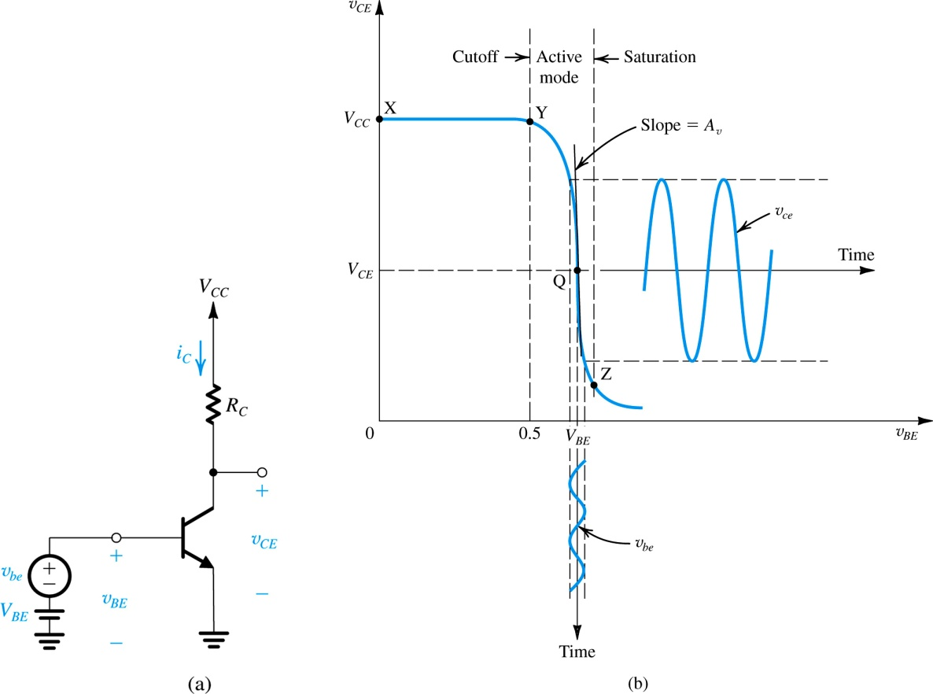


BJT amplifier biased at a point Q
A small signal voltage v_{be} is applied
The output signal v_{ce} appears superimposed on the dc collector voltage V_{CE}
$$v_{ce}=v_{out}$$
$$v_{in}$$
The amplitude of v_{ce} is larger than that of v_{be} by the voltage gain A_{v}

Slide 4
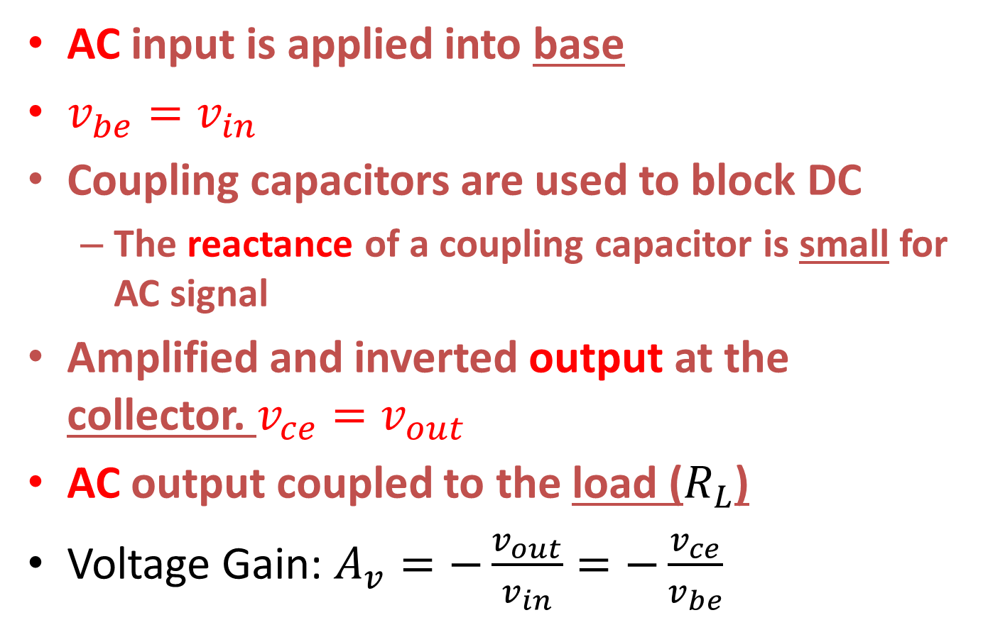
Base-biased amplifier
AC input is applied into base
$v_{be}=v_{in}$
Coupling capacitors are used to block DC
  The reactance of a coupling capacitor is small for AC signal
Amplified and inverted output at the collector. $v_{ce}=v_{out}$
AC output coupled to the load ($R_{L}$)
Voltage Gain: $A_{v}=−\frac{v_{out}}{v_{in}}=−\frac{v_{ce}}{v_{be}}$

Slide 5
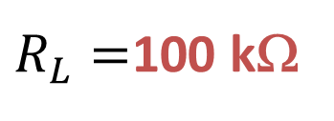
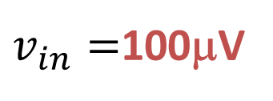
A base-biased amplifier with capacitive coupling
+30 V
Coupling capacitors are used to block DC
5 kΩ
1 MΩ
+ 15.35 V
0
β_{dc} = 100
0
$R_{L}=$100 kΩ
+0.7 V
$v_{in}=$100μV
DC analysis gives: I_{B} = 29.3 μA, I_{C} = 2.93 mA and V_{C} = 15.35 V

Slide 6

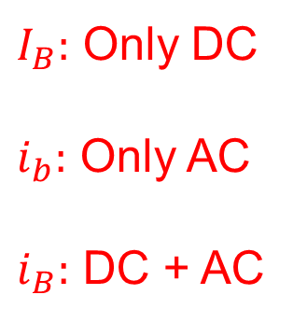


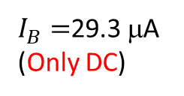

$$i_{B}$$
$i_{b}$ (Only AC)
$I_{B}=$29.3 μA (Only DC)
Base current
Waveforms
t
$I_{B}:$ Only DC
$i_{b}:$ Only AC
$i_{B}:$ DC + AC
$$i_{C}$$
2.93 mA
Collector current
t
$$v_{C}$$
15.35 V
Collector voltage
t

Slide 7
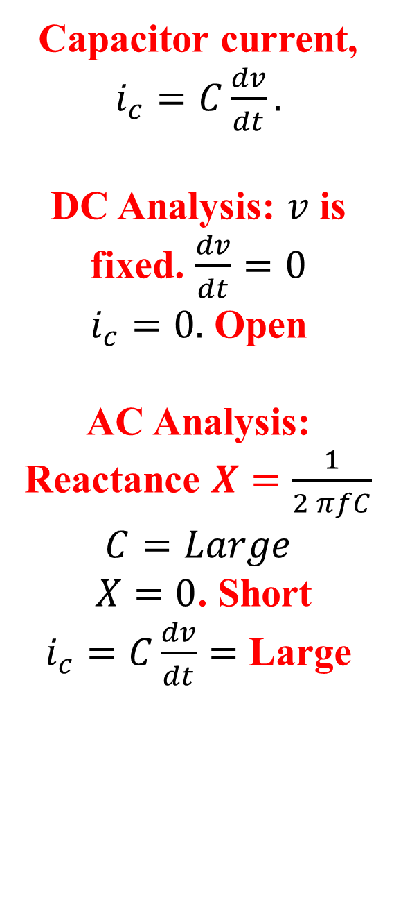




The coupling capacitor
Capacitor current, $i_{c}=C\frac{dv}{dt}.$
DC Analysis: $v$ is fixed. $\frac{dv}{dt}=0$
$i_{c}=0.$ Open
AC Analysis: Reactance $X=\frac{1}{2 πfC}$
$$C=Large$$
$X=0$. Short
$i_{c}=C\frac{dv}{dt}=$ Large
$$Open$$
$$Short$$
{
$$AC$$
$$DC$$
R
R
SHORT
OPEN
1. For ac analysis, the capacitor is a short.
2. For dc analysis, the capacitor is open.

Slide 8
BJT Amplifier Analysis
Superposition Theorem (DC + AC analysis)
DC voltages and currents are calculated mentally by opening capacitors: DC Analysis (Chapter 4)
The AC signal is coupled via a coupling capacitor
Coupling capacitor: couples between BJT & input AND BJT & output
The bypass capacitor causes an AC signal to appear across the base-emitter junction and provides higher gain
Bypass capacitor: Need in DC. Not need in AC.

Slide 9
VDB Amplifier
+10 V
Coupling Capacitors
3.6 kΩ
+6.04 V
10 kΩ
0
+1.8 V
0
100 kΩ
+1.1 V
2.2 kΩ
1 kΩ
100 μV
Bypass Capacitor

Slide 10
The dc current gain is given as:
I_{C}
β_{DC} =
I_{B}
The ac current gain is given as:
i_{c}
i_{b}
β_{ac} =
Use CAPITAL letters for dc quantities
and lowercase letters for ac.

Slide 11
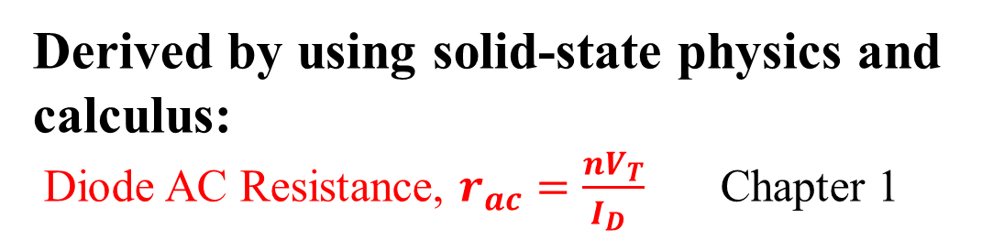


Formula for ac emitter resistance
Derived by using solid-state physics and calculus:
Diode AC Resistance, $r_{ac}=\frac{nV_{T}}{I_{D} }$ Chapter 1
$nV_{T}=$ 26 mV
r_{e}’ =
I_{E}
$r_{e}$ is AC emitter resistance
$I_{E}$ is DC emitter current

Slide 12
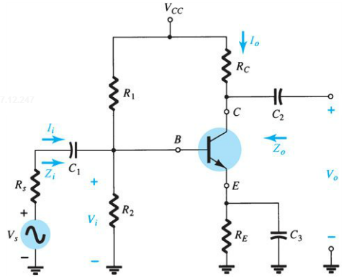
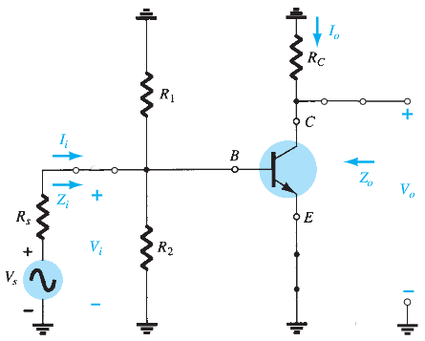
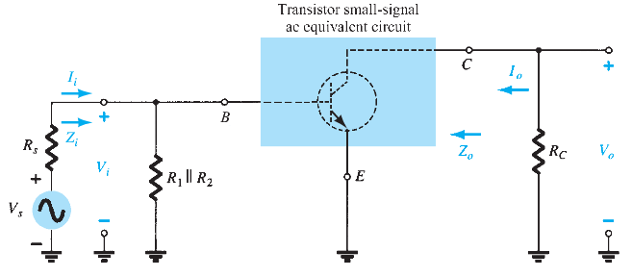
5.3 BJT TRANSISTOR MODELING
Transistor Circuit
AC Equivalent Circuit: After the removal of the dc supply and insertion of the short-circuit equivalent for the capacitors.
Redrawn for small-signal ac analysis

Slide 13
Transistor AC models
AC equivalent circuit for a transistor
Simulates how a transistor behaves when an ac signal is present
There are two models commonly used in small signal AC analysis of a transistor:
    r_{e} model
      T model and π type models are widely used
    Hybrid equivalent model (h parameter model)

Slide 14
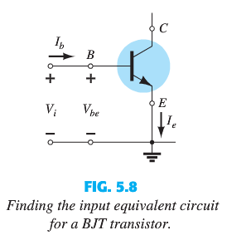
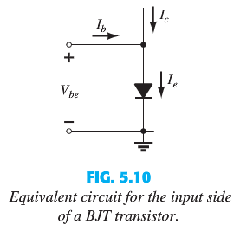
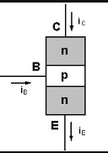


5.4 The $re$ Transistor Model
(The Input Equivalent Circuit)
B
E
BJT similar to two diodes, emitter-base (FB) and collector-base (RB)
$re$ Transistor Model: Diode between Emitter and Base

Slide 15
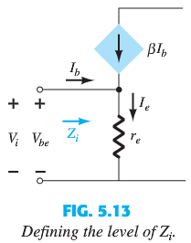
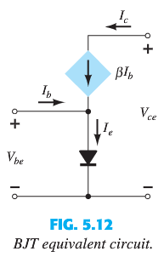



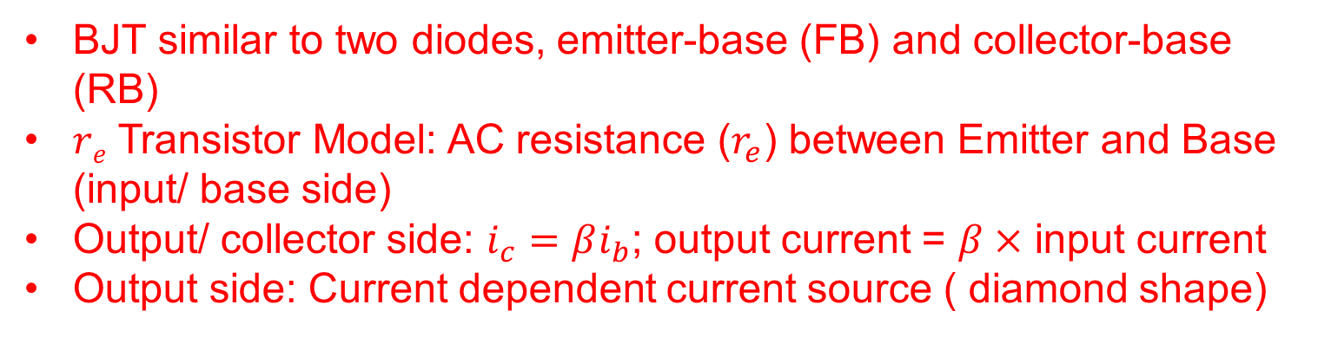
The r_{e} Transistor Model
(The BJT Equivalent Circuit – T Model)
$$C$$
$$B$$
$$E$$
BJT similar to two diodes, emitter-base (FB) and collector-base (RB)
$re$ Transistor Model: AC resistance ($r_{e}$) between Emitter and Base (input/ base side)
Output/ collector side: $i_{c}=βi_{b}$; output current = $β×$ input current
Output side: Current dependent current source ( diamond shape)

Slide 16

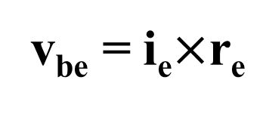
Deriving π model from T model
v_{be} = i_{e}$×$r_{e}
i_{c}
= (β+1) i_{b}r_{e}
$$≅\text{i}\text{b}×\text{b} \text{r}\text{e}$$
z_{in(base)}
i_{b}
r_{e}’
i_{e}

Slide 17
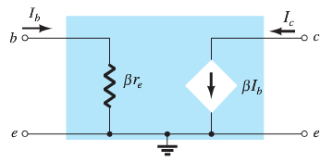
The π model of a transistor
is based on z_{in(base)} = βr_{e}:
i_{b}
z_{in(base)}
βr_{e}
I_{c}=βi_{b}
i_{e}

Slide 18
Overview of r_{e} Transistor Models
(T and π Model)
c
b
e
T Model
π Model

Slide 19
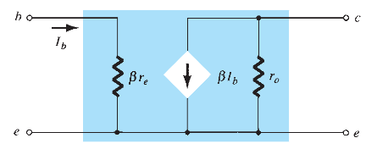

r_{e} model including effects of r_{o}
In practical transistors, collector current depends on collector voltage
Ideally, $r_{o}=∞$ ( Open circuit)
Practically, $r_{o}$ is very high but not infinity

Slide 20
BJT Amplifier AC analysis
Superposition theorem (DC + AC analysis)
Perform a complete DC analysis (Chapter 4)
Short all coupling and bypass capacitors for ac signals
Visualize all DC supply voltages as grounds
Replace the transistor by its π or T model
Draw the AC equivalent circuit

Slide 21
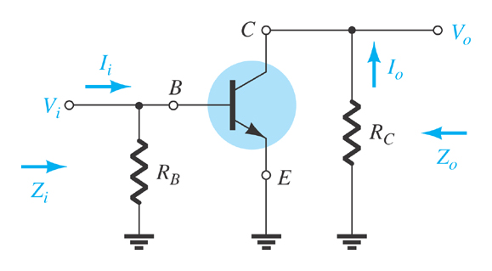
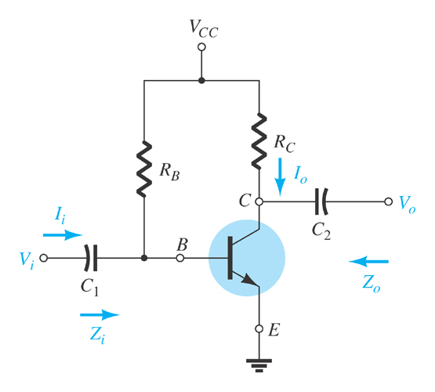
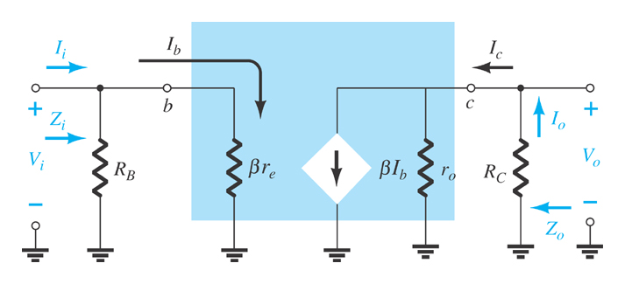
5.5 Common-Emitter
Fixed-Bias
Configuration
  AC equivalent
r_{e} model

Slide 22
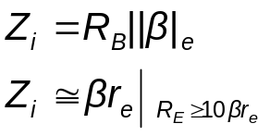
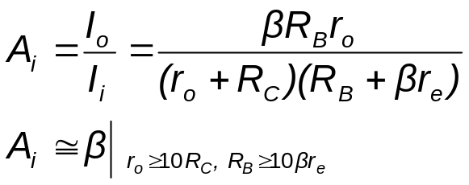
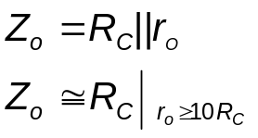
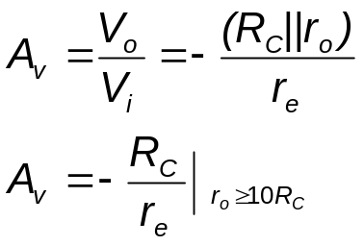
Common-Emitter Fixed-Bias Calculations
Input
impedance:
Current gain:
Output
impedance:
Voltage gain:

Slide 23
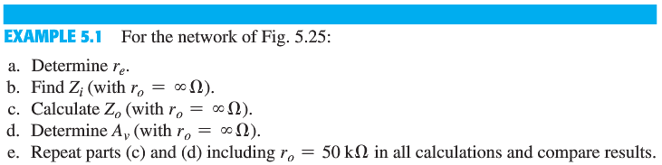
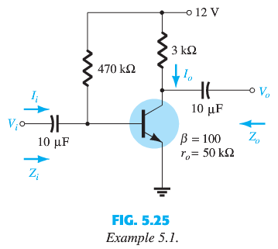
1. Short all coupling and bypass capacitors for ac signals
2. DC supply voltages as grounds
3. Replace the transistor by its π or T model
Model: CE
T model: CB
4. Draw the AC equivalent circuit

Slide 25
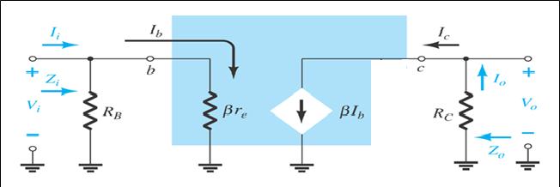
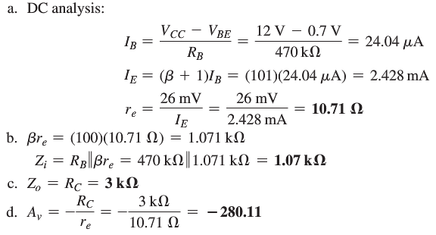
OUTPUT
INPUT

Slide 26
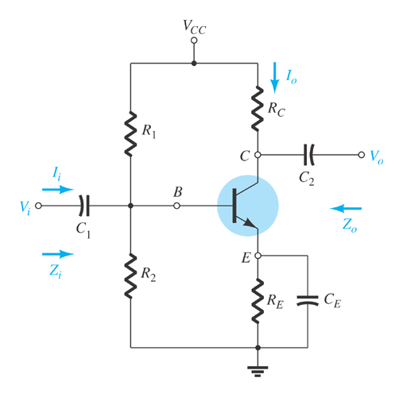
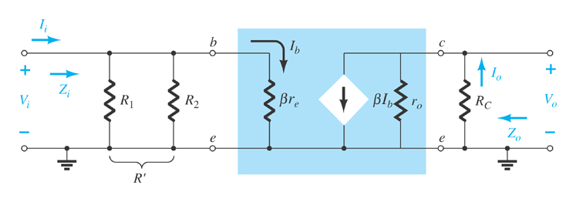
5.6 Common-Emitter Voltage-Divider Bias
r_{e} model requires you to determine β, r_{e}, and r_{o}.

Slide 27
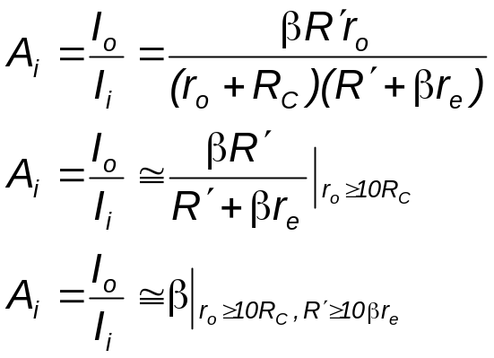
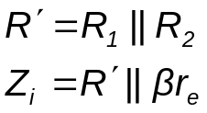
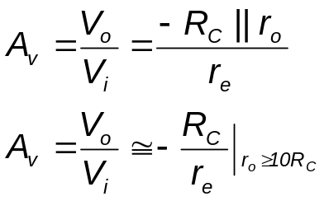
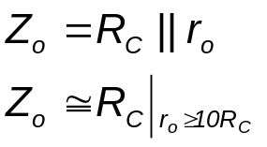
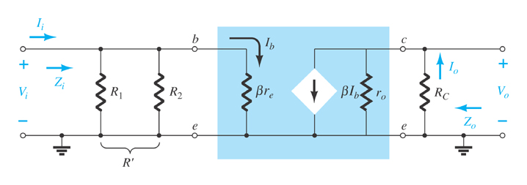
5.6 Common-Emitter
Voltage-Divider Bias
Current gain
Input impedance
Voltage gain
Output impedance

Slide 28
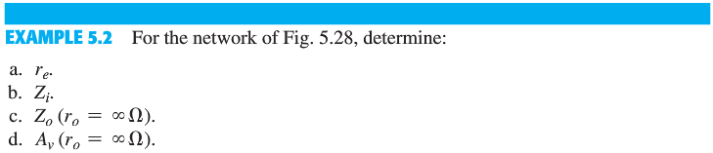
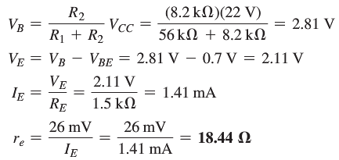
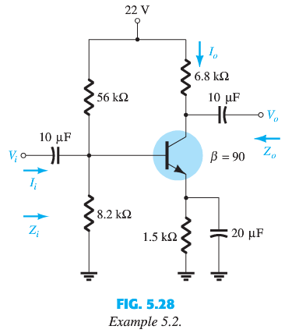

Slide 29
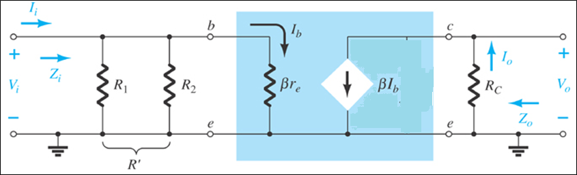
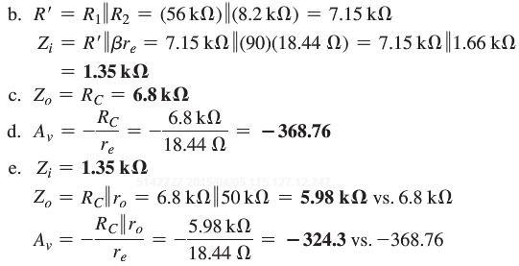

Slide 30
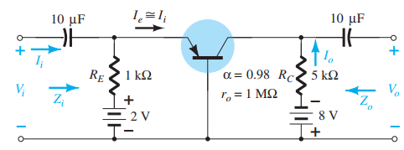
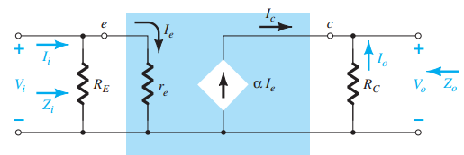

Example 5.8: Common Base BJT Amplifier
Common base PNP: $r_{e}$ T model
Input: emitter; output: collector
Output Current: $I_{C}=βI_{B}=αI_{E}=α×$ input current

Slide 31
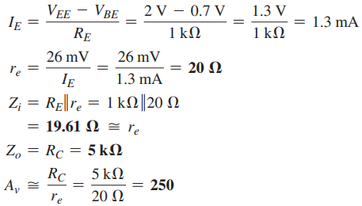
Example 5.8: Common Base BJT Amplifier

Slide 32
5.16 Cascaded Systems
To get more gain, a cascaded amplifier can be used.
Stage 1
Stage 2
A_{V1}
A_{V2}
R_{L}
v_{out}
v_{in}
z_{in(stage 2)}
The overall voltage gain: A_{V} = A_{V1}A_{V2}
The output of one amplifier is the input to the next amplifier
The DC bias circuits are isolated from each other by the coupling capacitors

